Slide 1
Data management plan and resulting obligations
Benjamin Pfeil
Leader Bjerknes Climate Data Centre
Acting Director of the RI ICOS Ocean Thematic Centre
Geophysical Institute, University of Bergen, Norway

Slide 2
Structure
Background
Formal obligations
FAIR
Obligations of the hosting institution
Open access
Open Research Data Pilot
Exersise
Take home message

Slide 3
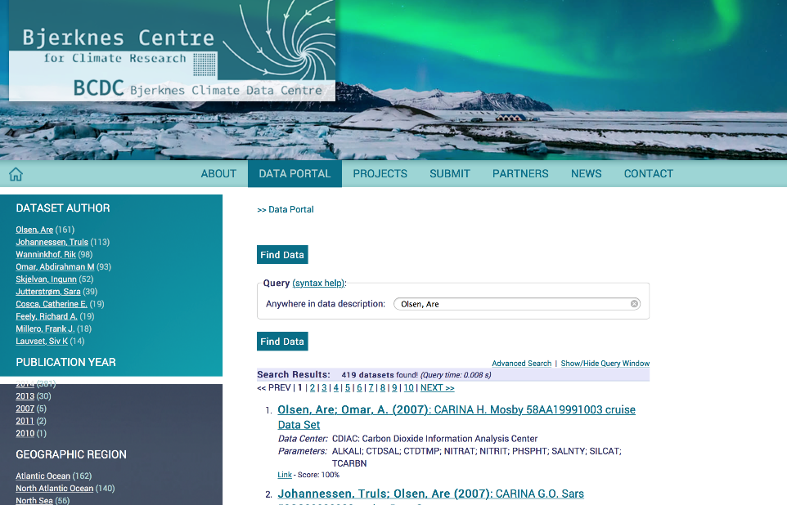

Slide 4
Main focus on services – ensuring data to be FAIR!
Complimentary efforts with long-term archives
Pangaea
Contribute to UN SDG 14
Archive and publish data
Norstore/NIRD
What we do
NMDC
Join data-strategy projects and research infrastructures
Create data management plans and project work
SDC
ICOS
Contribute in creation of data products
Copernicus
GCB
GLODAP
SOCAT

Slide 5
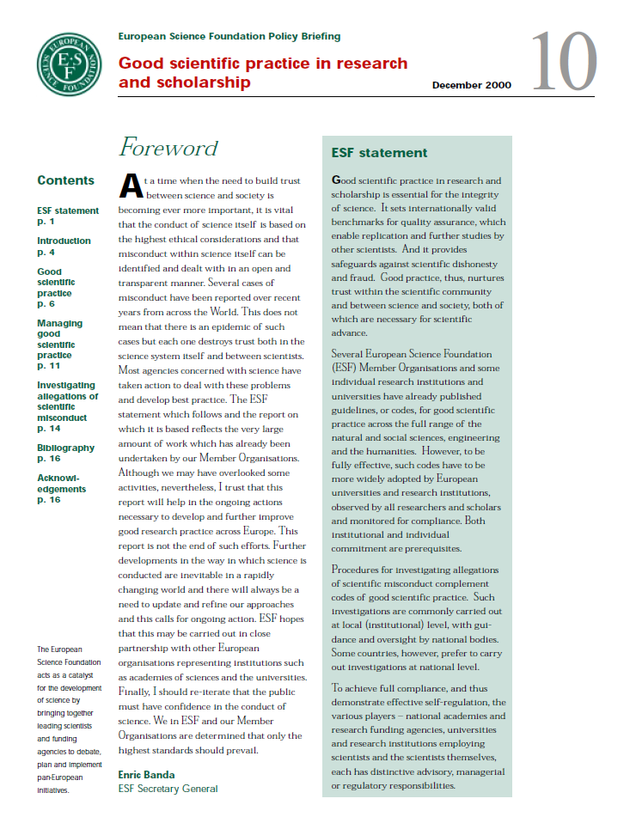
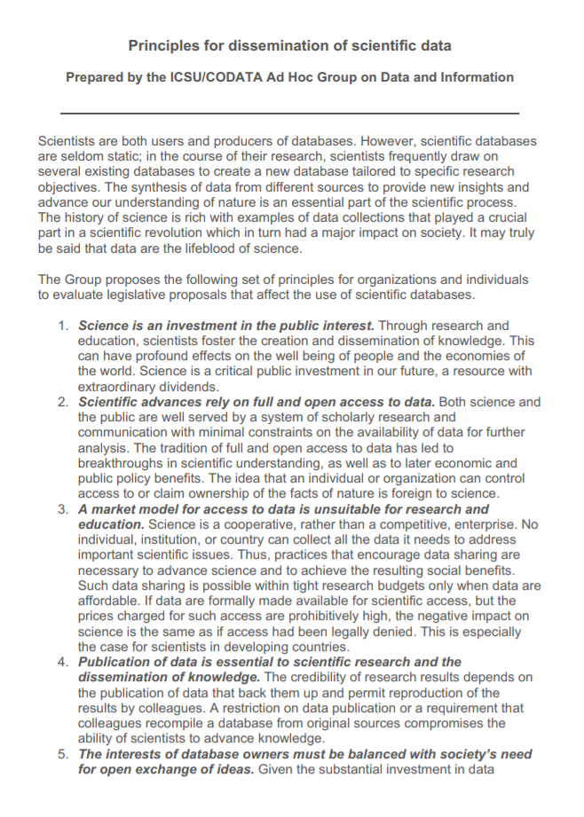
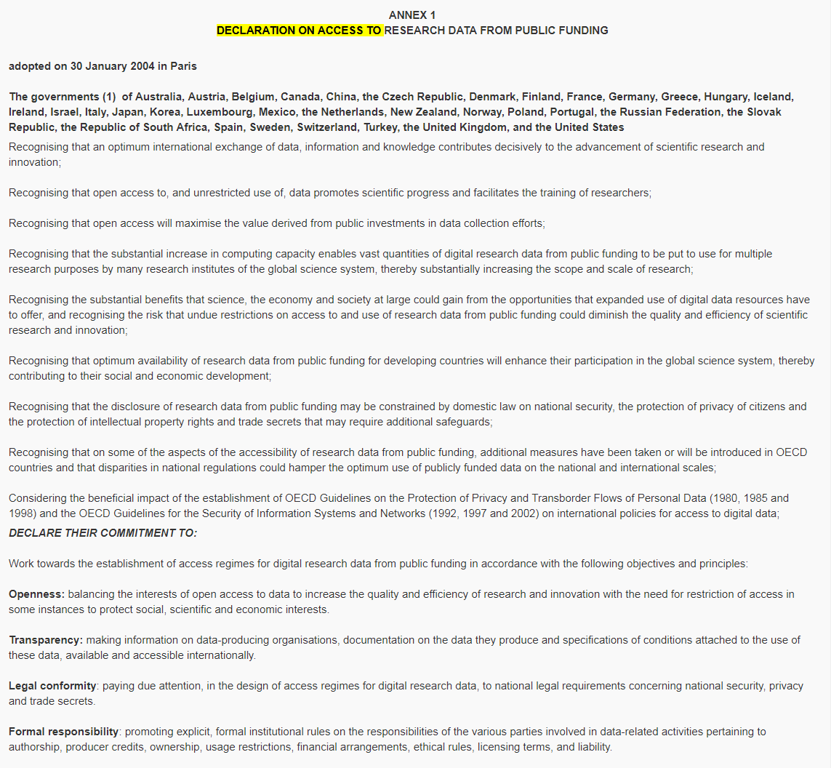
Formal obligations since 2000
Notes:
Services connect the technical infrastructure with the user

Slide 6
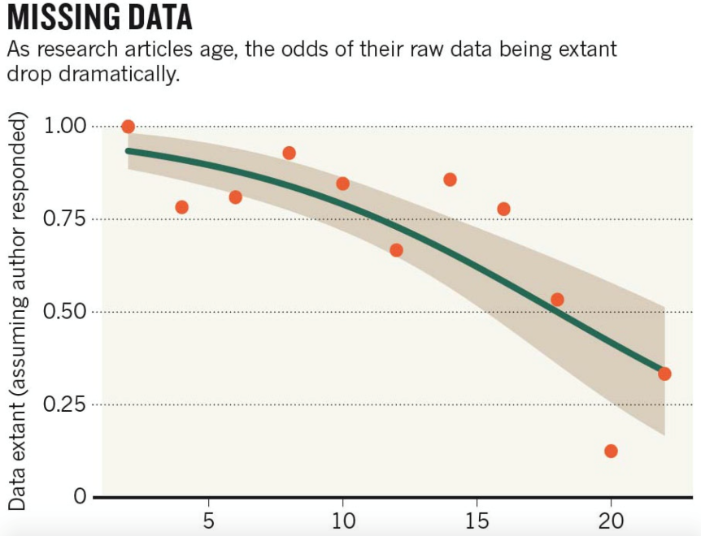
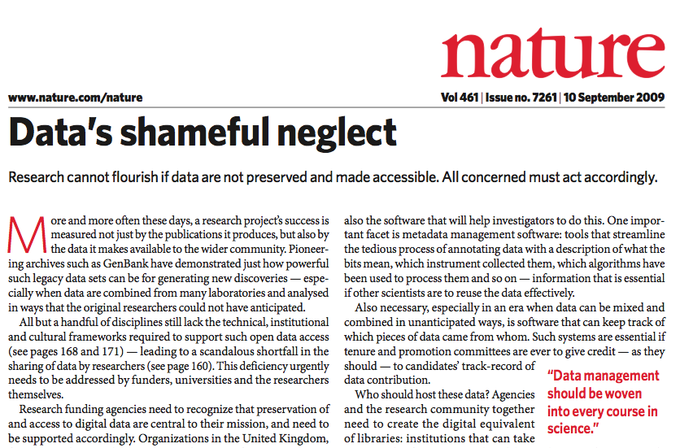
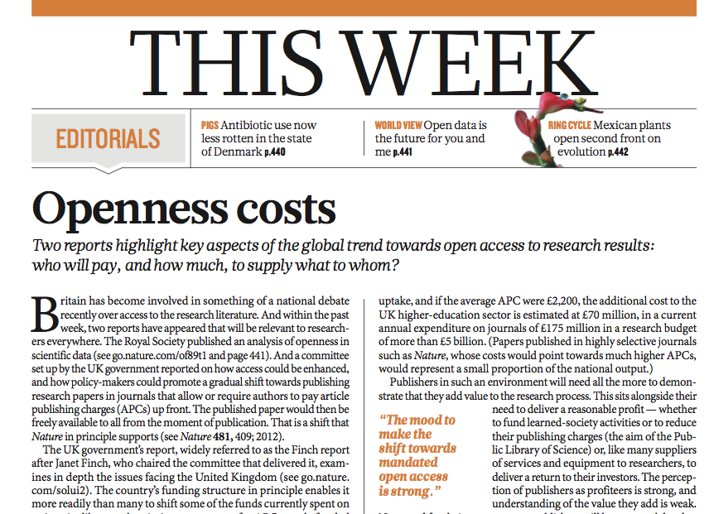
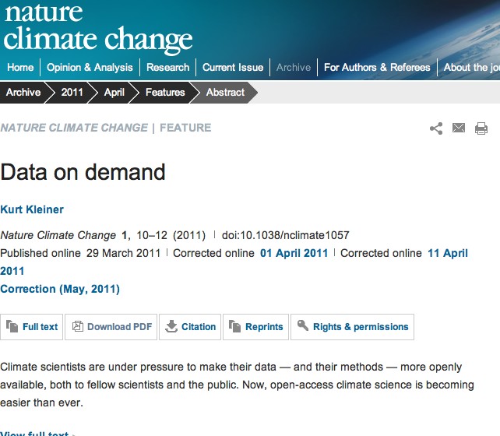
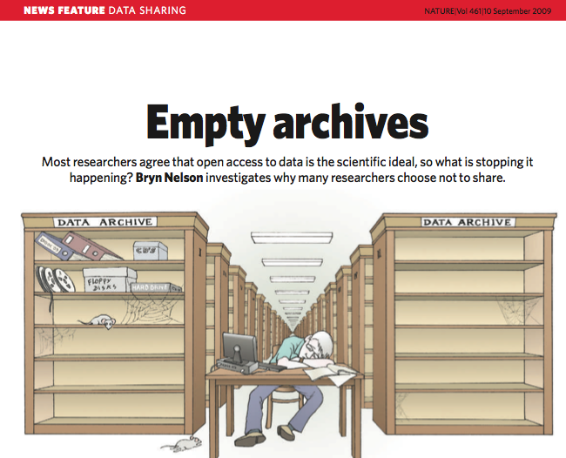
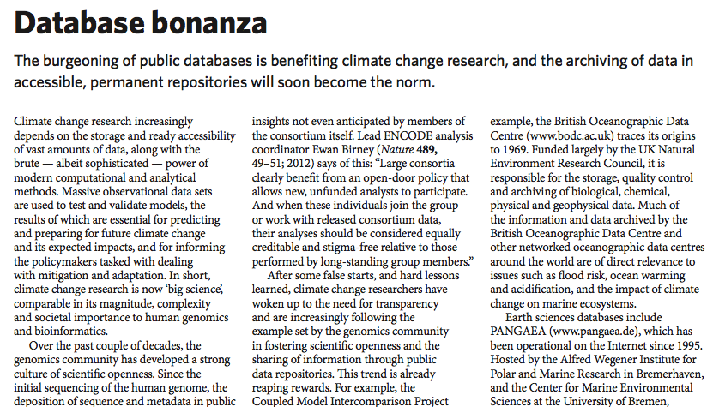
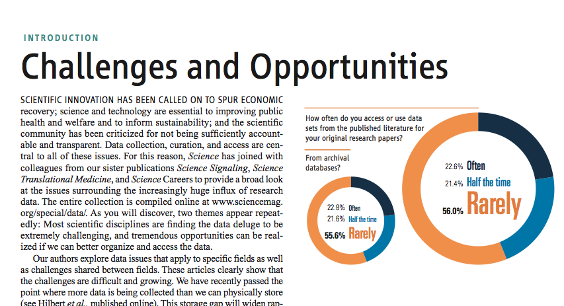
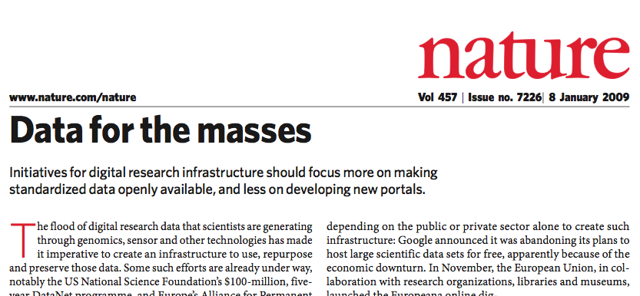
Literature
Need for archiving scientific data
Research is held back by the absence of sustainable archives for data and structured data management
Funding agencies, professional societies, and publishers each have unfulfilled roles in archive design and data management policies

Slide 7
Good scientific practice in research and scholarship
European Science Foundation (ESF), 2000
Data accumulation, handling, and storage
36. Data are produced at all stages in experimental research and in scholarship. Data sets are an important resource, which enable later verification of scientific interpretations and conclusions. They may also be the starting point for further studies. It is vital, therefore, that all primary and secondary data are stored in a secure and accessible form.
37. Institutions may pay particular attention to documenting and archiving original research and scholarship data. Several codes of good practice recommend a minimum period of 10 years, longer in the case of especially significant or sensitive data. National or regional discipline-based archives should be considered where there are practical or other problems in storing data at the institution where the research was conducted.

Slide 8
Principles for dissemination of scientific data
(ISCU/CODATA, 2000)
4. Scientific advances rely on full and open access to data. Both science and the public are well served by a system of scholarly research and communication with minimal constraints on the availability of data for further analysis. The tradition of full and open access to data has led to breakthroughs in scientific understanding, as well as to later economic and public policy benefits. The idea that an individual or organization can control access to or claim ownership of the facts of nature is foreign to science.
5. The interests of database owners must be balanced with society’s need for open exchange of ideas. Given the substantial investment in data collection and its importance to society, it is equally important that data are used to the maximum extent possible. Data that were collected for a variety of purposes may be useful to science. Legal foundations and societal attitudes should foster a balance between individual rights to data and the public good of shared data.

Slide 9
Norway (+30 OECD lands) signed the Declaration on Access to Research Data from Public Funding, January 2004
Source: http://acts.oecd.org

Slide 10
OECD Principles and Guidelines for Access to Research Data from Public Funding (2007)
The rapid development in computing technology and the Internet have opened up new applications for the basic sources of research — the base material of research data — which has given a major impetus to scientific work in recent years. Databases are rapidly becoming an essential part of the infrastructure of the global science system. The international Human Genome Project is but one good example of a large-scale endeavour in which openly accessible information is being used successfully by many different users, all over the world, for a great variety of purposes.

Slide 11
OECD Principles and Guidelines for Access to Research Data from Public Funding (2007)
Promote a culture of openness and sharing of research data among the public research communities within member countries and beyond;
Stimulate the exchange of good practices in data access and sharing;
Raise awareness about the potential costs and benefits of restrictions and limitations on access to and the sharing of research data from public funding;
Highlight the need to consider data access and sharing regulations and practices in the formation of member countries’ science policies and programmes;
The Principles and Guidelines should assist governments, research support and funding organisations, research institutions and researchers themselves in dealing with the barriers and challenges in improving the international sharing of, and access to, research data.

Slide 12
Publishers
Data underlying scientific publications have to be open!
Being enforced by rejecting papers
2/3 of all publications can not be reproduced!

Slide 13
Forskningsrådet: Åpen tilgang til forskningsdata (2014): Forskningsrådets policy for åpen tilgang til offentlig finansierte forskningsdata skal bidra til at forskningsdata er tilgjengelige for relevante brukere, på like betingelser, til lavest mulig kostnad. Retningslinjene i policyen gjelder alle data i prosjekter som er finansiert av Forskningsrådet – med noen unntak.
Policyen er formulert som en rekke anbefalinger – ikke krav. Forskningsrådets virkemidler vil i framtida tilpasses prinsippene i policyen. Et mulig tiltak er å innføre krav om datahåndteringsplaner i prosjekter.

Slide 14
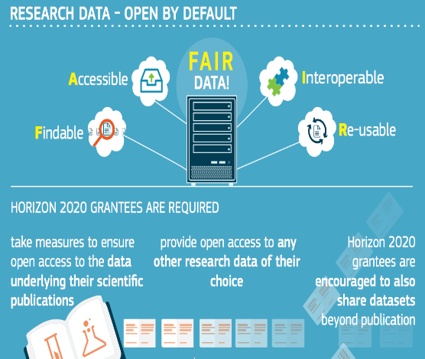
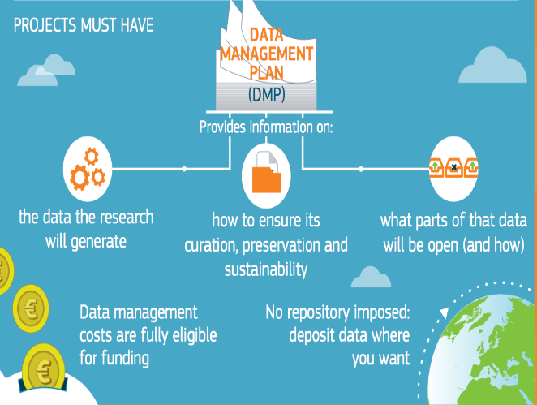
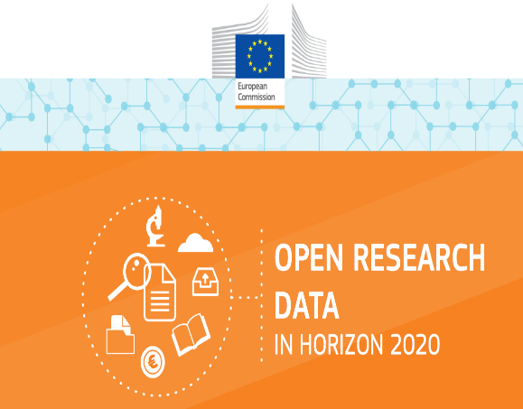
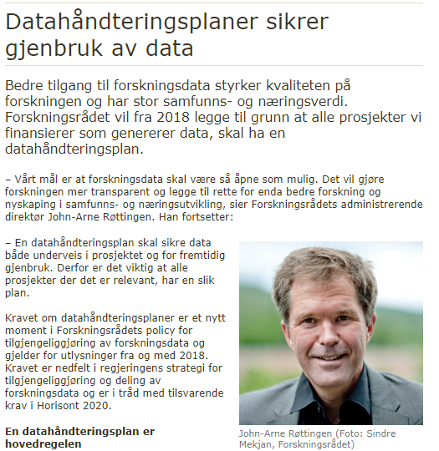
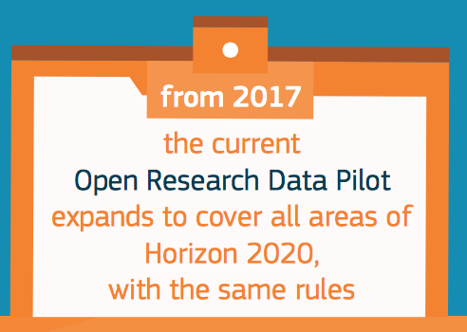
Juridical obligations since 2018:
Data management is mandatory for all EU and NFR projects
Notes:
Services connect the technical infrastructure with the user

Slide 15
Guidelines on the Implementation of Open Access to Scientific Publications and Research Data in Projects supported by the European Research Council under Horizon 2020
Open access to publications and data
ERC grants must ensure open access to all peer-reviewed scientific publications relating to its results.
Open access to research data
Open Research Data Pilot (ORD Pilot) – mandatory!
Beneficiaries must deposit the data in a research data repository so that it is possible to access, mine, exploit, reproduce and disseminate the data
Provide a Data Management Plan (DMP)

Slide 16
Open Research Data Pilot
The Open Research Data Pilot of the European Commission enables open access and reuse of research data generated by Horizon 2020 projects. There are two main pillars to the Pilot:
developing a Data Management Plan (DMP)
providing open access to research data, if possible.
The conditions you have to adhere to, are:
Develop (and keep up-to-date) a Data Management Plan (DMP).
Deposit your data in a research data repository.
Ensure third parties can freely access, mine, exploit, reproduce and disseminate your data.
Provide related information and identify (or provide) the tools needed to use the raw data to validate your research.
The Pilot applies to:
The data (and metadata) needed to validate results in scientific publications.
Other curated and/or raw data (and metadata) that you specify in the DMP.

Slide 17
Extended Pilot On Open Access To Research Data
The Commission has enabled access to and reuse of research data generated by Horizon 2020 projects through the Open Research Data Pilot (ORD Pilot). As stated in the 2017 work programme, the pilot is being extended to cover all thematic areas.
Open research data will be monitored throughout Horizon 2020 with a view to further developing the Commission's policy on open science.

Slide 18
Open access
Open access (OA) refers to the practice of providing online access to scientific information that is free of charge to the end-user and reusable. 'Scientific' refers to all academic disciplines. In the context of research and innovation, 'scientific information' can mean:
peer-reviewed scientific research articles (published in scholarly journals), or
research data (data underlying publications, curated data and/or raw data).
Open access to research data
Refers to the right to access and reuse digital research data under the terms and conditions set out in the Grant Agreement.

Slide 19
Two main roads to open access:
Self-archiving / 'green' open access – the author, or a representative, archives (deposits) the published article or the final peer-reviewed manuscript in an online repository before, at the same time as, or after publication. Some publishers request that open access be granted only after an embargo period has elapsed.
Open access publishing / 'gold' open access - an article is immediately published in open access mode. In this model, the payment of publication costs is shifted away from subscribing readers.
The costs of open access publishing are covered by subsidies or other funding models.

Slide 20
Research data
Refers to information, in particular facts or numbers, collected to be examined and considered as a basis for reasoning, discussion, or calculation.
In a research context, examples of data include statistics, results of experiments, measurements, observations resulting from fieldwork, survey results, interview recordings and images. The focus is on research data that is available in digital form.
Users can normally access, mine, exploit, reproduce and disseminate openly accessible research data free of charge.

Slide 21
Open access for publications and research data

Slide 22
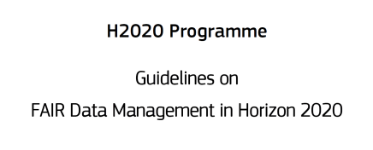
Aim to make research data FAIR
Findable
Accessible
Interoperable
Reusable
Good research data management is not a goal in itself, but rather the key conduit leading to knowledge discovery and innovation, and to subsequent data and knowledge integration and reuse.
"as open as possible, as closed as necessary" and focuses on encouraging sound data management as an essential part of research best practice.
Source: https://data.europa.eu

Slide 23
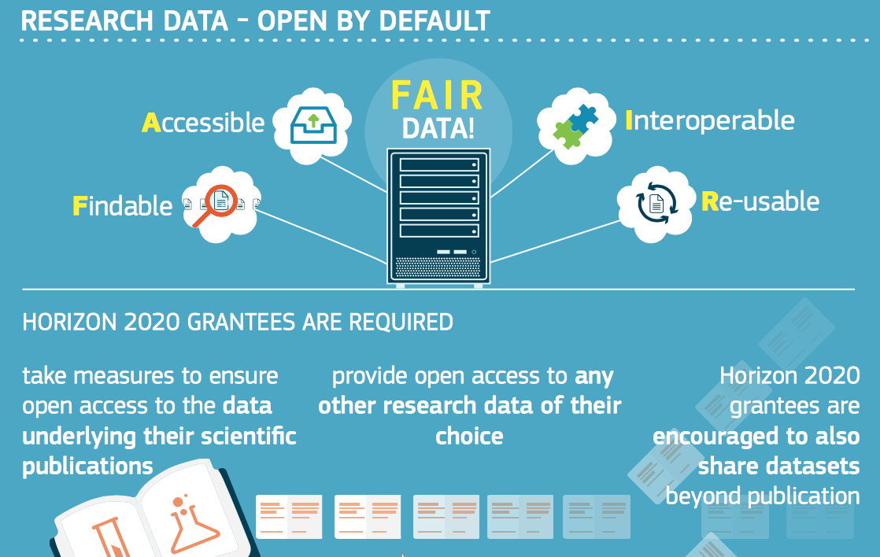
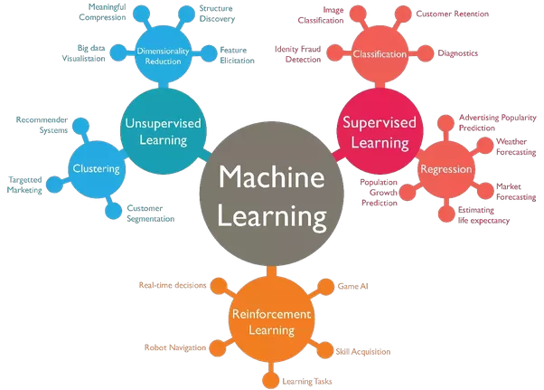
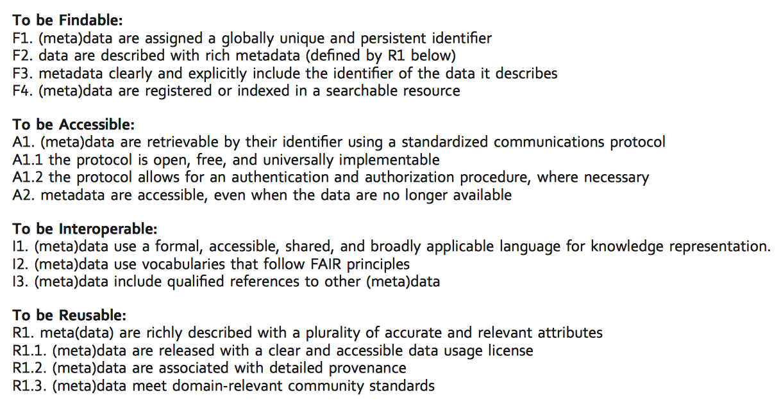
Handling metadata is not enough for A, I and R

Slide 24
Data management plan
Purpose
The purpose of a DMP is to plan how to safeguard the research data, not just during the project period, but also for future reuse of the data. A DMP can also help you to plan how to cover data management and storage costs.
Has to be provided normally at Month 6

Slide 25
Data management plan (DMP)
As part of making research data findable, accessible, interoperable and re-usable (FAIR), a DMP should include information on:
• the handling of research data during and after the end of the project
• what data will be collected, processed and/or generated
• which methodology and standards will be applied
• whether data will be shared/made open access and
• how data will be curated and preserved (including after the end of the project).
Source: https://data.europa.eu

Slide 26
Who has the responsibility for the quality and content of the DMP?
For all projects that receive funding from the NFR or ERC, the R&D-performing institutions or companies should assess whether projects must develop a data management plan.
If the project manager decides that a data management plan is necessary, the project will draw up a plan in accordance with the institution's own guidelines. This plan must be delivered at the time of the revision of the application.
When the final report of the project is to be submitted, the Research Council will request a final version of the data management plan. The project will not be asked to report on revisions of the plan during the project period.
If the project manager decides that the project does not need a data management plan, an explanation for this must be provided when submitting the revised application.
As far as possible, data management plans should be made public and openly accessible by the research-performing institution to enable scientific groups to follow peer practice.

Slide 27
Opting out – partially or entirely
By extending the pilot, open access becomes the default setting for research data generated in Horizon 2020.
However, not all data can be open. Projects can therefore opt out at any stage (either before or after signing the grant) and so free themselves retroactively from the obligations associated with the conditions – if:
participation is incompatible with the obligation to protect results that can reasonably be expected to be commercially or industrially exploited
participation is incompatible with the need for confidentiality in connection with security issues
participation is incompatible with rules on protecting personal data
participation would mean that the project's main aim might not be achieved
the project will not generate / collect any research data or
there are other legitimate reasons (you can enter these in a free-text box at the proposal stage).
The Commission's approach can therefore be described as "as open as possible, as closed as necessary".

Slide 28
Proposal Submission & Evaluation
Whether a proposed project participates in the ORD pilot or chooses to opt out does not affect the evaluation of that project. In other words, proposals will not be penalized for opting out of the extended ORD pilot.
Since participation in the ORD pilot is not an evaluation criterion, the proposal is not expected to contain a fully developed DMP. However, good research data management as such should be addressed under the impact criterion, as relevant to the project.
Your application should address the following issues:
How will data be exploited &/or shared/made accessible for verification & reuse? If data cannot be made available, why not?
Your policy should reflect the current state of consortium agreements on data management
be consistent with exploitation and Intellectual Property Rights (IPR) requirements
You should also ensure resource and budgetary planning for data management and include a deliverable for an initial DMP at month 6 at the latest into your proposal.

Slide 29
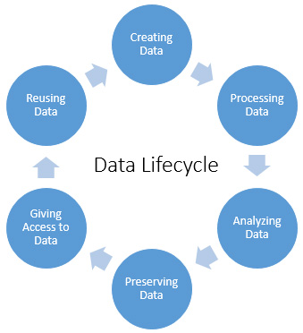
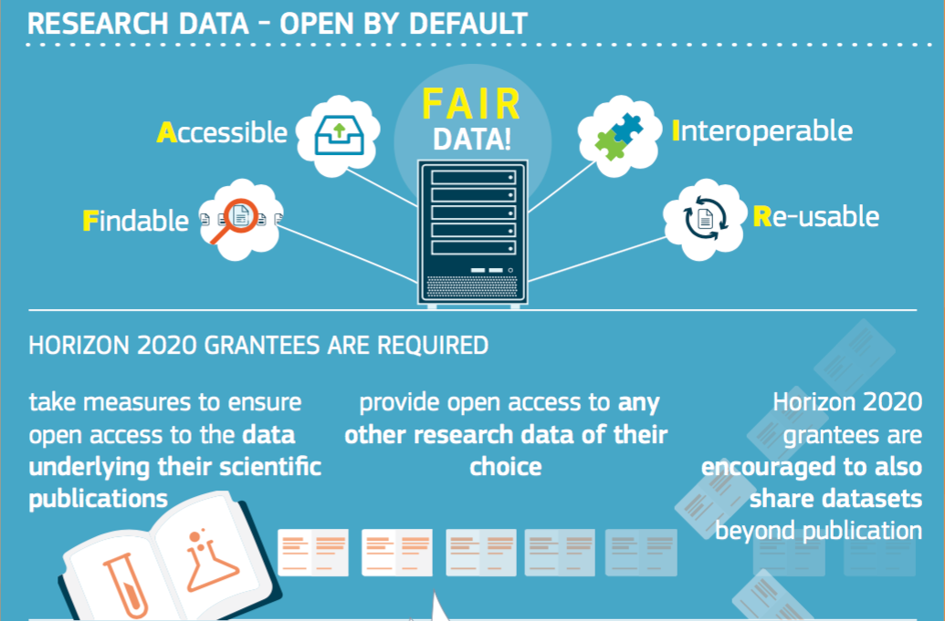
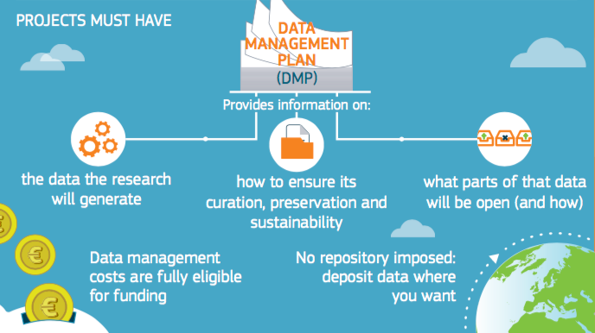
Obligations of the beneficiary: Managing our research data according to FAIR principle
Notes:
Pluss 16 faste jobber ved Norsk Marin Datasenter /IMR!

Slide 31
Costs related to open access to research data in Horizon 2020 are eligible for reimbursement during the duration of the project under the conditions defined in the H2020 Grant Agreement
Provides template for a DMP (similar to the British Data Curation Centre)
Source: https://data.europa.eu

Slide 32
Why open access to publications and data?
Modern research builds on extensive scientific dialogue and advances by improving earlier work. The Europe 2020 strategy for a smart, sustainable and inclusive economy underlines the central role of knowledge and innovation in generating growth. Broader access to scientific publications and data therefore helps to:
build on previous research results (improved quality of results)
encourage collaboration and avoid duplication of effort (greater efficiency)
speed up innovation (faster progress to market means faster growth)
involve citizens and society (improved transparency of the scientific process).

Slide 33
Open Science cloud
Future challenges/
obligations

Slide 34
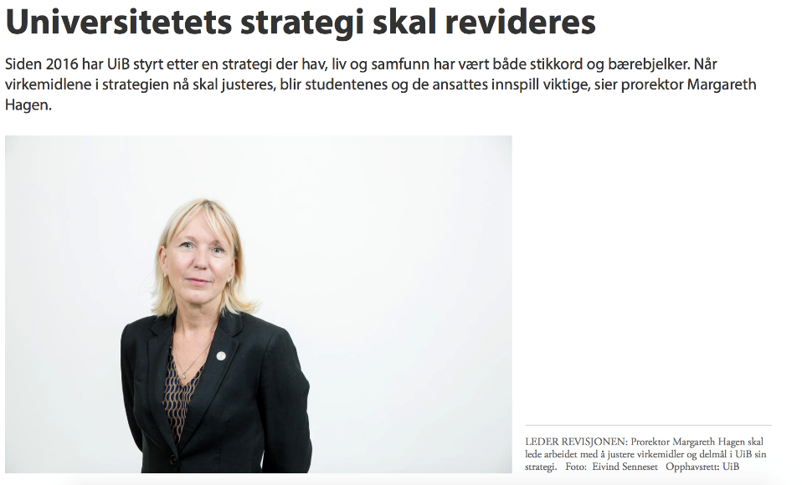
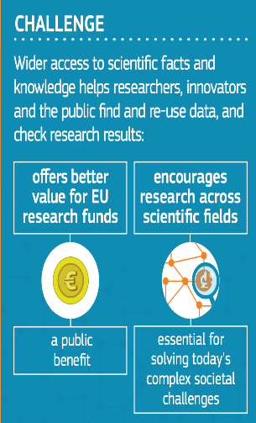
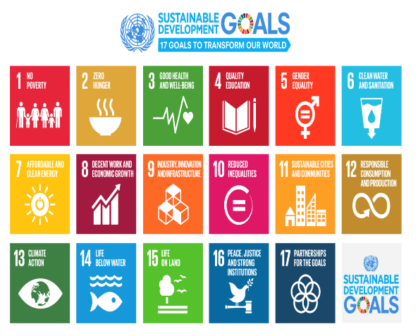
Societal obligations – data sharing to secure the future
Notes:
Consistent effort is essential for the success

Slide 35
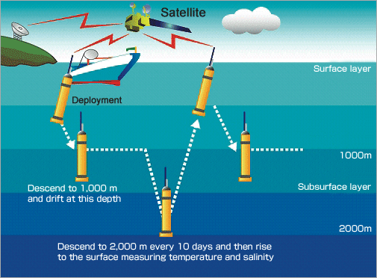
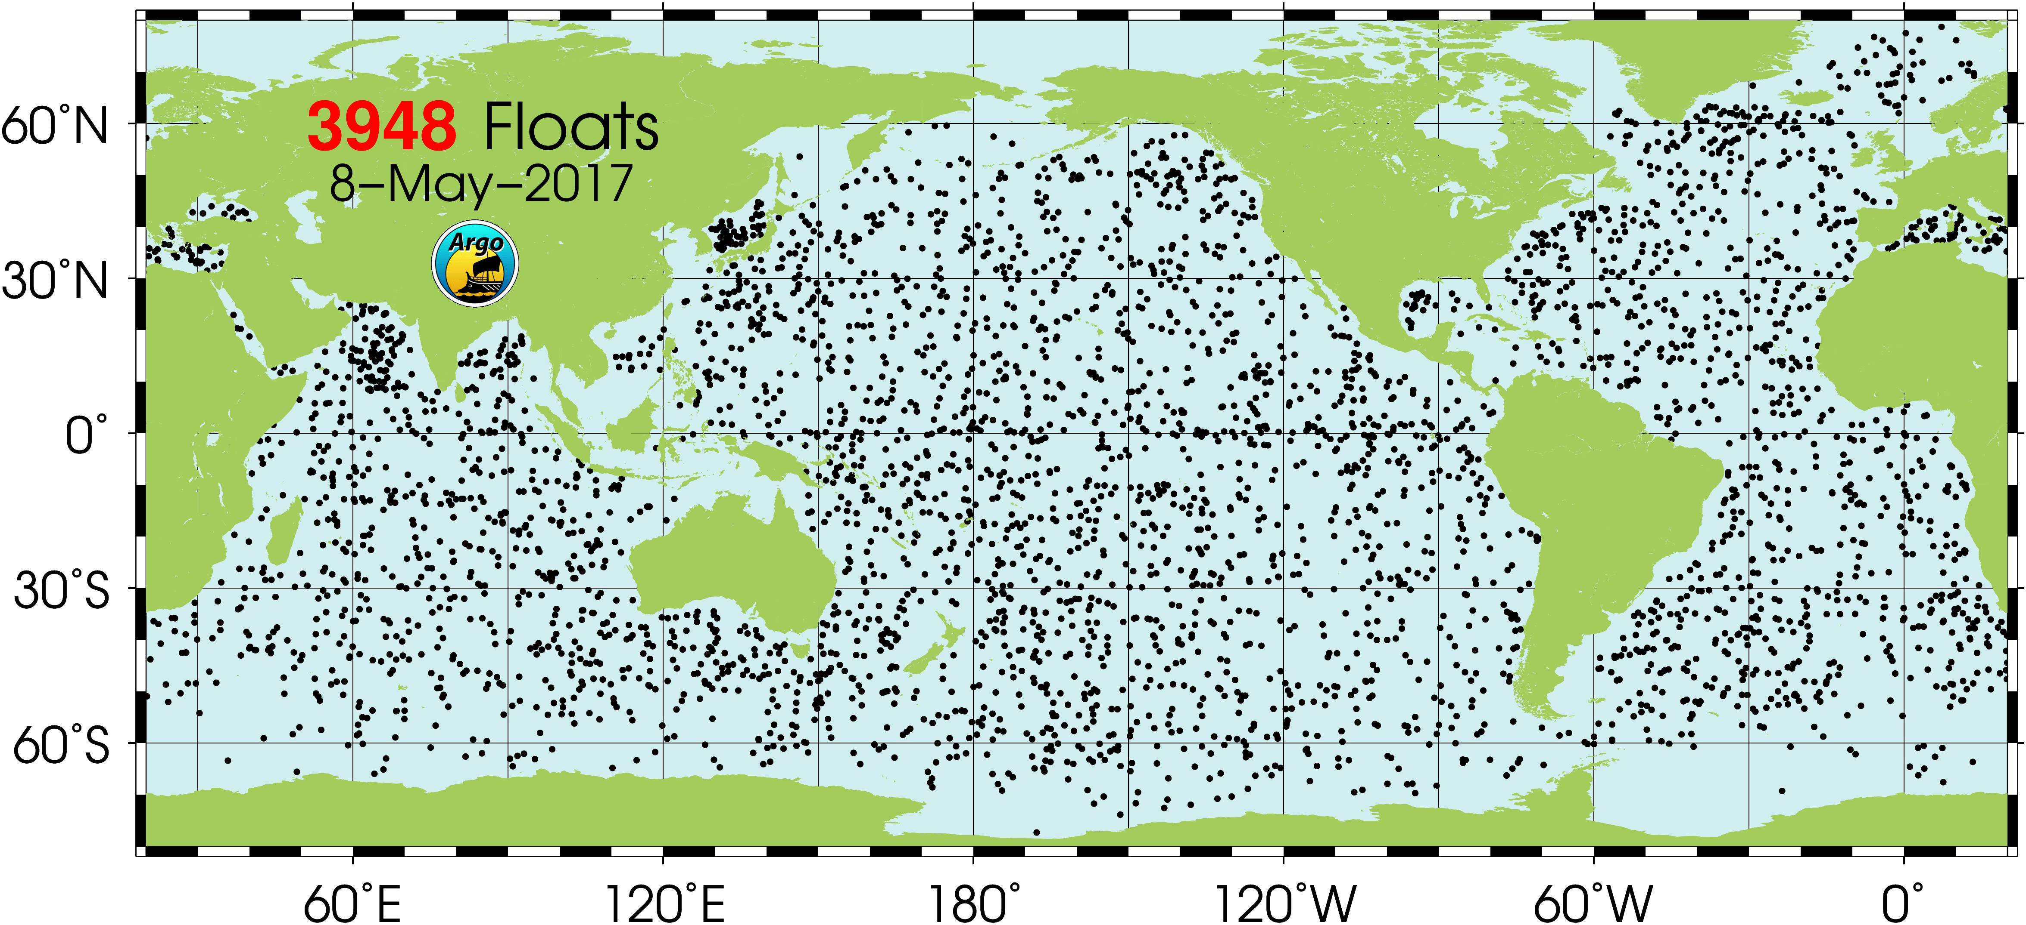
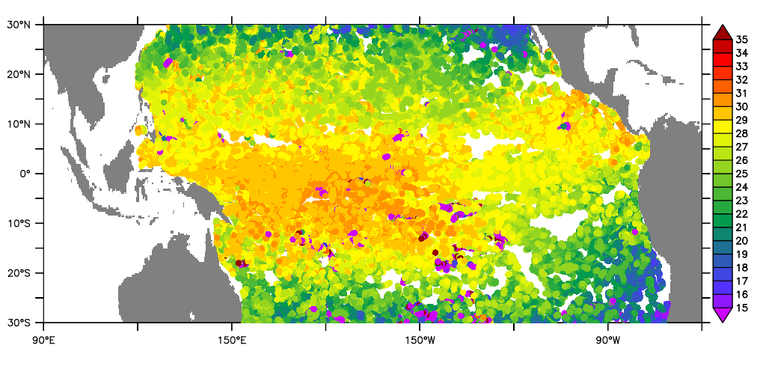
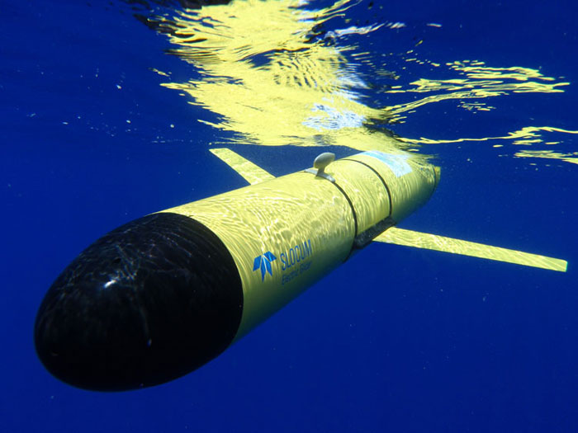
FAIR: Integrating Data and Information Across Observing Systems -> Fitness of Use /Fit for Purpose
Example from BCDC work: data products
Data availability via DAP (Data Access Protocol) services e.g. OPeNDAP
allowing interoperable access to data from various observing networks

Slide 36
Exercise:
There are several providers of tools that generate data management plans for research projects. The solutions make it possible to update the data management plan during the project period. Here are examples of tools for generating data management plans that exist today:
Try make a data management plan
Use either
EasyDMP https://easydmp.sigma2.no/plan/
NSD http://www.nsd.uib.no/arkivering/datahandteringsplan.html
Digital Curation Centre https://dmponline.dcc.ac.uk

Slide 37
Take home messages
Start thinking about a DMP during the writing phase
If external help is needed to achieve FAIRness – reserve funding before submitting
Required funding varies and depends on the field of research
No reserved funding for a DMP either PI does it or hosting institution with in-kind
Addressing data management can improve the chance of getting funding
There has to be a good reason for ‘Opting out’ (I do not want to share is no reason)
The hosting institution owns the research data that is generated at it’s institution and has to ensure that policies are followed (ORDP)
Failing the obligations in the DMP is a contract violation
The major task is not write a DMP but to follow it up

Slide 38
‘The value of data lies in their use.’
Bits of Power, Issues on Global Access to Scientific Data, US National Research Council 1997

